Slide 1
SCREEN RECORDER USING PYTHON

Slide 2
TABLE OF CONTENTS
1.INTRODUCTION
Introduction to project
Identification of problem
2.BACKGROUND STUDY
Existing solutions
Problem Definition
Goals/Objectives
3.DESIGN FLOW/PROCESS
Evaluation & Selection of Specifications/Features
Analysis of Features and finalization subject to constraints
Design Flow
4.RESULTS ANALYSIS AND VALIDATION
Implementation of solution
Output and Findings
5.CONCLUCATION AND FUTURE WORK
Conclusion
Future work

Slide 3
Introduction
Our project focuses on developing a Python-based screen recording application using libraries like OpenCV, PIL, NumPy, and screeninfo. Screen recording is essential in fields such as education, software development, and technical support. This tool captures and stores screen activity as a video, designed to be simple, efficient, and versatile for tutorials, lectures, software demos, or troubleshooting. Python's multimedia support, with OpenCV for video processing, PIL for screenshot capture, and screeninfo for adapting to different displays, ensures flexibility and ease of use.

Slide 4
Identification of Problem
While many screen recording tools are available, several challenges persist for users:
High Resource Consumption: Most popular software uses significant CPU and memory, causing poor performance on low-end systems.
Licensing and Costs: Tools like Camtasia and Bandicam require payment for premium features, which may be unaffordable.
Complexity and Learning Curve: Advanced tools such as OBS Studio are difficult for non-technical users to navigate.
Lack of Customization: Limited options for customizing settings like frame rate, resolution, and encoding formats.

Slide 5
BACKGROUND STUDY
We explored several screen recording tools to understand their pros and cons:
OBS Studio: A feature-rich, open-source tool for live streaming and recording, offering custom configurations and multi-source capture. However, its complexity and high resource usage can be overwhelming for users seeking simplicity.
Camtasia: Known for its intuitive interface and robust editing features, Camtasia allows for easy recording and editing but is a paid tool with a high cost, limiting its accessibility.
Bandicam: Efficient for recording gameplay with high compression and customizable settings. However, the free version limits recording time and adds watermarks to videos.
Free & Open-Source Tools: Tools like Simple Screen Recorder, Kazam, and Share X offer decent functionality but may lack advanced features or cross-platform support.

Slide 6
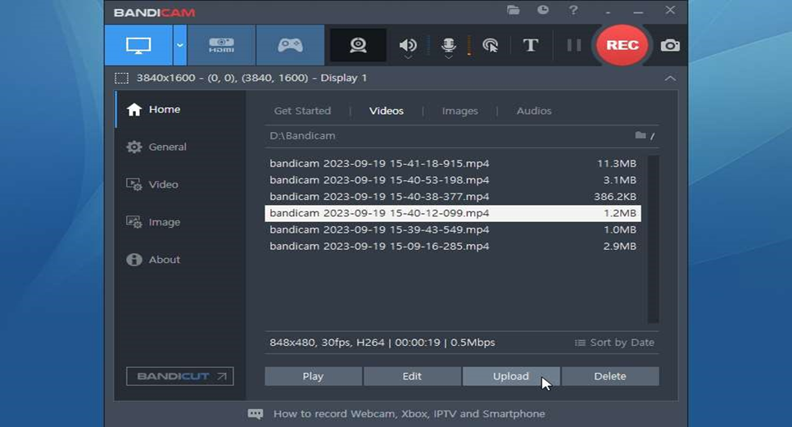
Problem Definition
Existing screen recording tools force users to compromise on functionality, cost, and ease of use. Most solutions either charge for advanced features, are resource-intensive, or have a steep learning curve.
Key Issues:
High costs of premium tools like Camtasia
Resource-heavy performance in OBS Studio, affecting efficiency
Limited customization in free or open-source software
Cross-platform compatibility challenges, especially for Linux and macOS users

Slide 7
Goals/Objectives
Develop a lightweight, customizable screen recorder for real-time video capture with minimal resource use.
Provide a free, open-source solution for personal, educational, and professional purposes.
Enable real-time video processing and support standard video formats (e.g., MP4) for broad compatibility.
Ensure smooth performance on basic hardware while maintaining a balance between video quality and efficiency.
Allow users to customize recording settings such as frame rate and resolution to meet different needs.

Slide 8
DESIGN FLOW/PROCESS
OpenCV: Offers real-time video manipulation, handling video frames efficiently, and supporting multiple codecs.
PIL (Pillow): Simplifies screen capture and image processing tasks like cropping, resizing, and format conversion.
NumPy: Manages data conversion between images and arrays for efficient frame handling and compatibility with OpenCV.
screeninfo: Automatically adapts to different screen resolutions, supporting various monitors and display setups.

Slide 9
Analysis of Features and Finalization Subject to Constraints
System Resources: The application must minimize CPU and memory usage, ensuring smooth real-time processing on lower-end systems.
User Simplicity vs. Customizability: The interface should remain simple for non-technical users while allowing basic customization without overcomplicating core functionality.
Compatibility: Cross-platform support is essential, though initial development focuses on Windows.
Finalized Features: Real-time screen capture with adjustable frame rates.

Slide 10
Design Flow
Retrieve Screen Dimensions: Use screeninfo to detect monitors and set capture area.
Initialize Video Writer: Set up cv2.VideoWriter with codec, file name, frame rate, and resolution.
Capture Screen Continuously: Use ImageGrab.grab() in a loop to capture and convert the screen to a NumPy array.
Process Frame Data: Convert from RGB to BGR for OpenCV compatibility, and display a preview.
Save Frame to File:Write each frame to the video file. Check for 'Esc' key to stop recording.
Release Resources & Save File: Release VideoWriter and save the output video to disk.

Slide 11
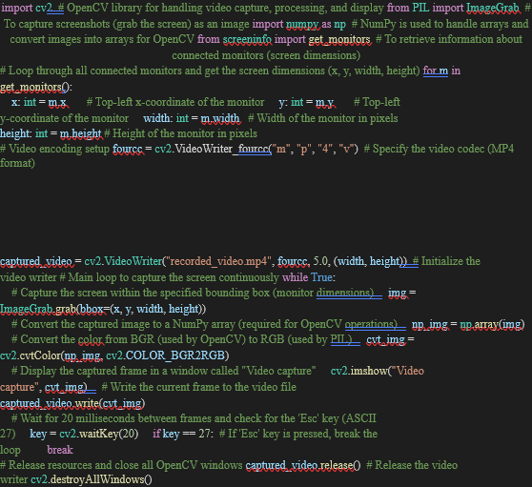
RESULTS ANALYSIS AND VALIDATION
Implementation of Solution
Python-Based Application: Developed using Python for flexibility and ease of integration.
Libraries Installed & Configured: Key libraries like OpenCV, Pillow, screeninfo, and numpy were installed for screen capture, video processing, and recording.
Virtual Environment Setup: A virtual environment was created to manage dependencies efficiently and keep the development environment clean.
Multi-System Testing: The application was tested on various systems to ensure consistent performance across different hardware configurations.

Slide 12
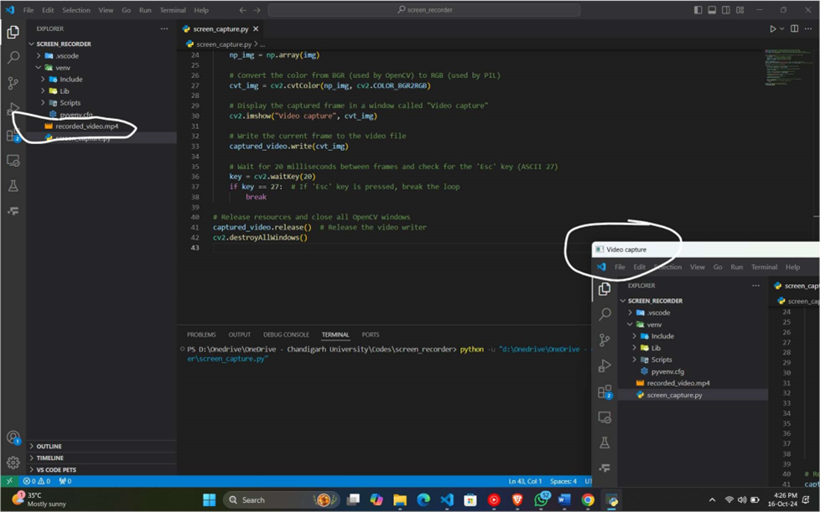
Output and Findings
Video Capture Output:
As seen in the image, the program runs as "video capture".
The screen being recorded is visible in the capture window.
Recorded Video:
The output video file is saved as "recorded_video.mp4".
This file shows the recorded screen content captured by the application.
CPU Performance:
The project utilizes only 6% of CPU power during operation.
Comparatively, alternative screen recording software consumes 25-30% CPU, demonstrating better efficiency of this solution.

Slide 13
CONCLUSION AND FUTURE WORK
Conclusion
The project successfully created a simple yet effective screen recording tool.
It provides real-time screen capture with video encoding, displaying the content as it is recorded.
The solution is well-suited for basic use cases like:
Recording tutorials
Troubleshooting sessions
Overall, the application delivers a lightweight, efficient, and reliable screen recording experience.

Slide 14
Future Work
Feature Enhancements: Integrate audio recording capabilities into the screen recorder.
Performance Optimization: Improve frame rates for smoother video recording.
Graphical User Interface (GUI):Develop a user-friendly GUI to simplify usage.
Cross-Platform Compatibility: Extend support for macOS and Linux systems.
Audio Recording Synchronization: Ensure synchronization of video and audio capture.

Slide 15
THANK YOU

